Slide 1


Customer
Churn Prediction
Mentorness Internship Program
Presented by G.Guru Charan
MIP-ML-08

Slide 2

Agenda
Introduction
Problem Statement
Overview of the Dataset
Understanding the Dataset
Feature Selection
Model Building
Model Comparision
Conclusion

Slide 3

Introduction
In this project we will dive into the world of classification tasks and gain hands-on experience in data analysis, preprocessing, and machine learning model development. Customer churn, the discontinuation of business with a company, is a critical challenge in various industries, and our task is to predict it accurately.

Slide 4


Problem
Statement
Customer churn is a crucial concern for businesses across sectors. Understanding customer behaviors, identifying key factors contributing to churn, and predicting when customers are likely to churn are vital for reducing revenue loss and enhancing customer retention strategies.

Slide 5
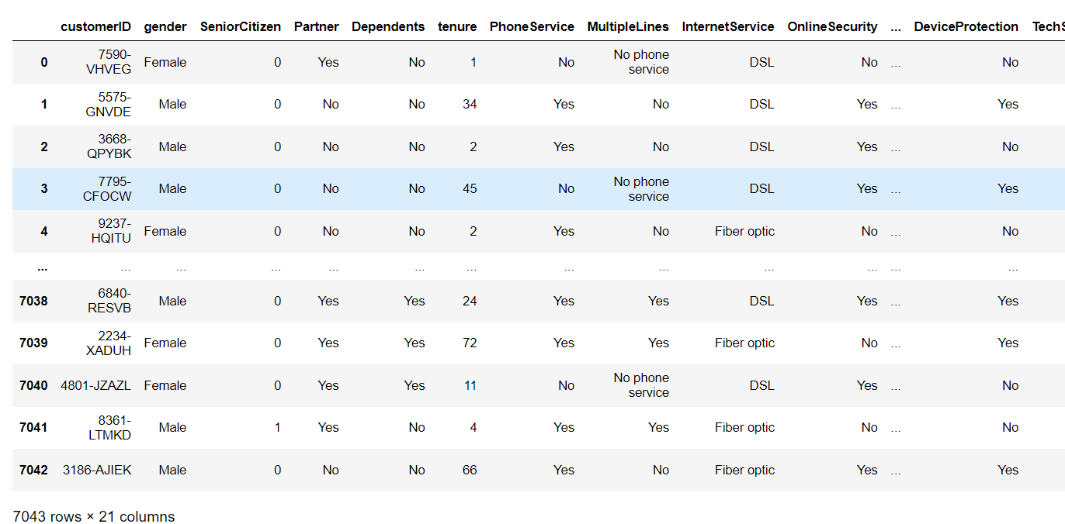
Overview of Dataset

Slide 6

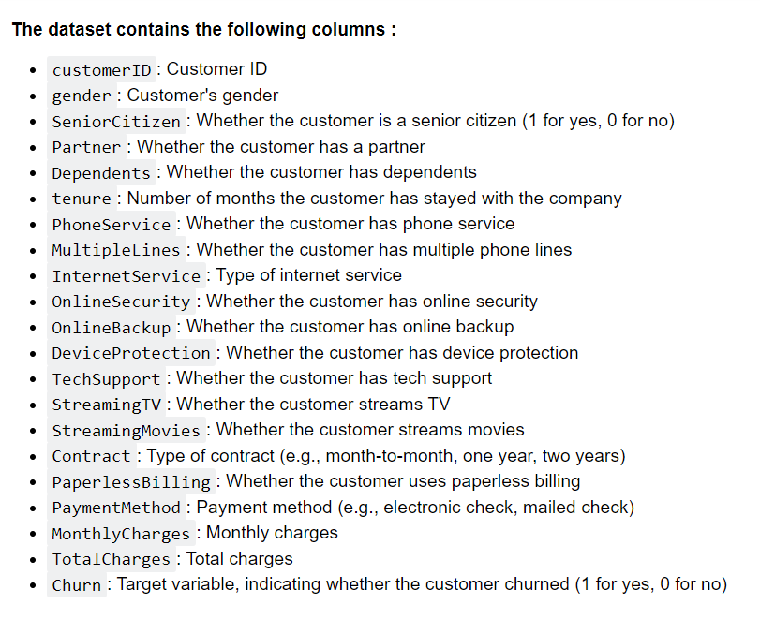
Understanding the Dataset

Slide 7
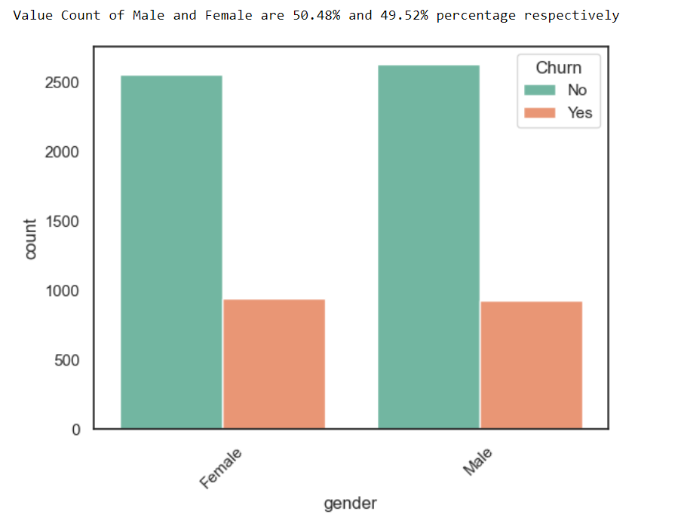
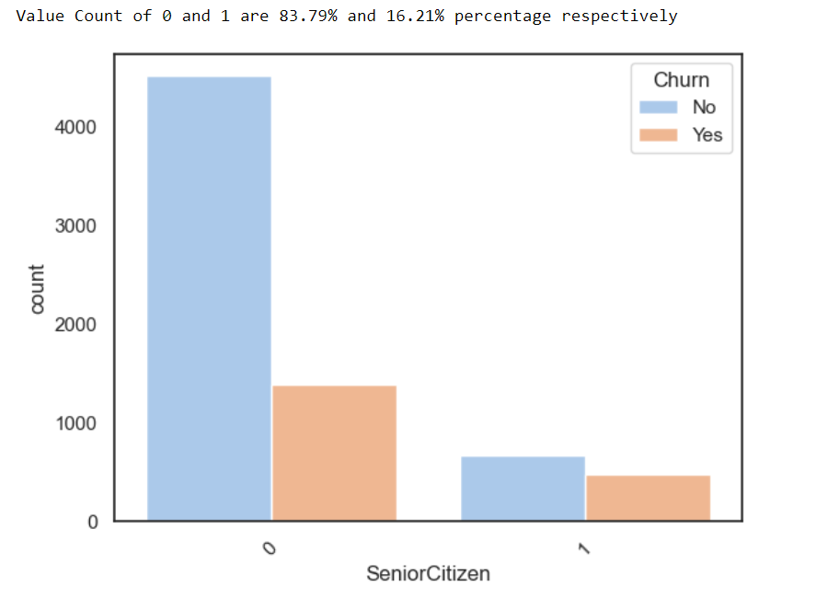
Analyzing the Data

Slide 8
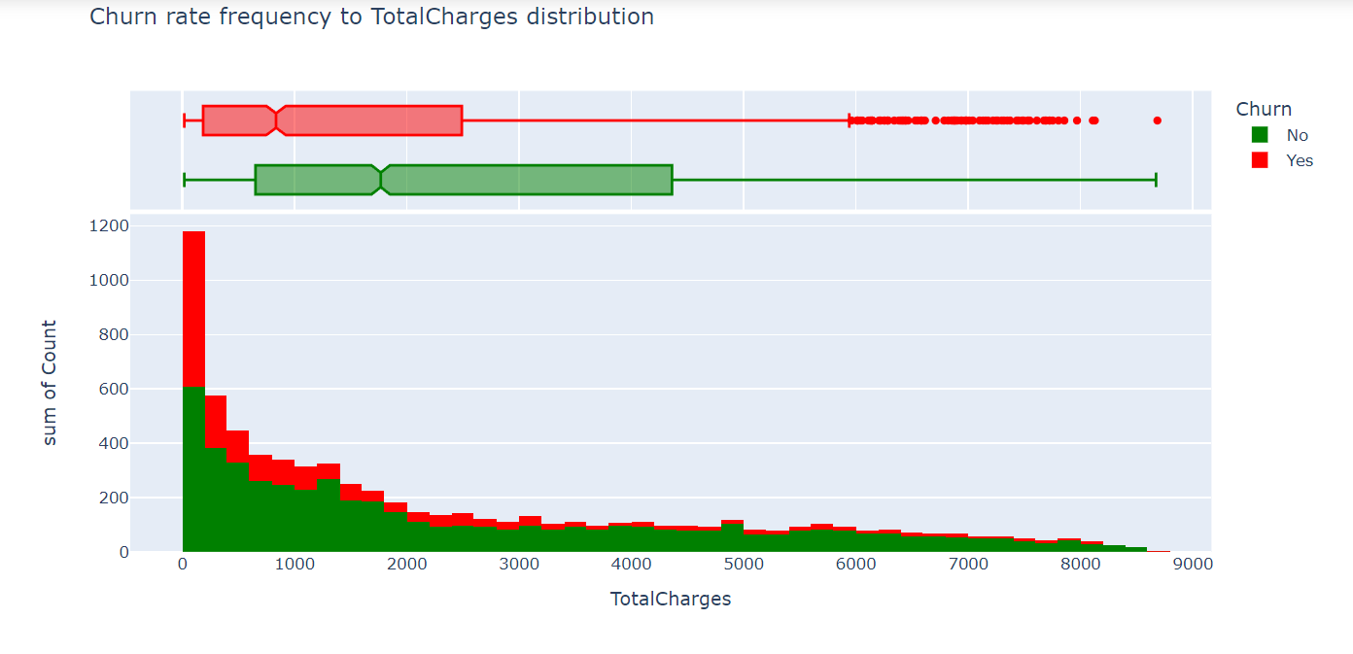
Customer account information : The tenure histogram is rightly skewed and shows that majority of customers has been with the telecom company for just the first few months (0-9 months) and the highest rate of churn is also in that first few months (0-9months). 75% of customers who end up leaving Telcom company do so within their first 30 months. The monthly charge histogram shows that clients with higher monthly charges have a higher churn rate (This suggests that discounts and promotions can be an enticing reason for customers to stay).

Slide 9

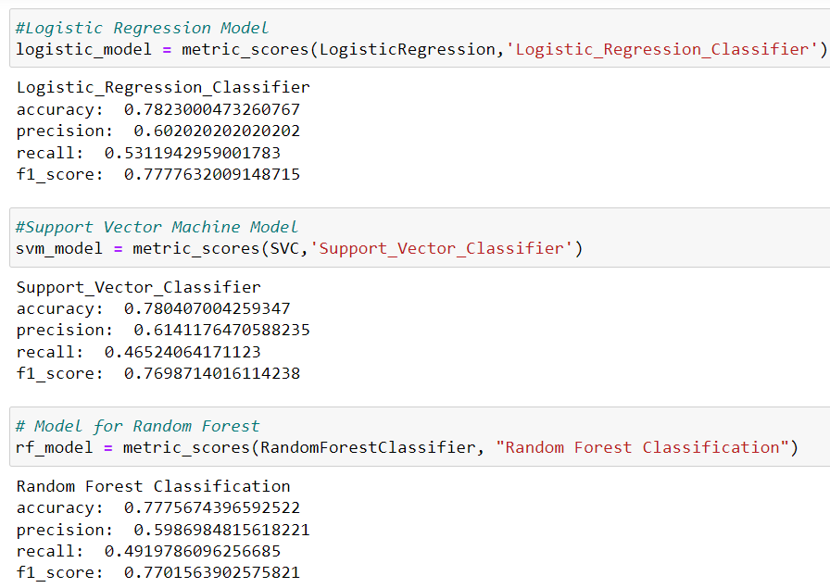
Model
Building

Slide 10

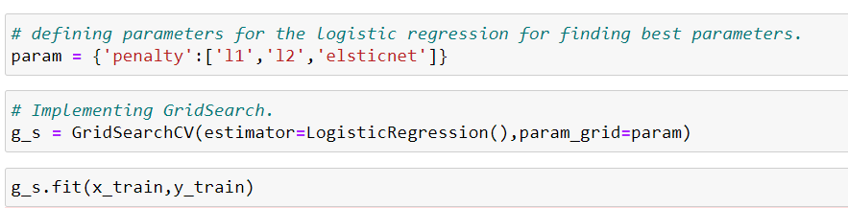
Model
Selection

Slide 11

Conclusion

Slide 12

Thank you very much!

